Slide 1
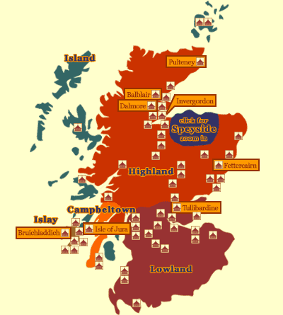
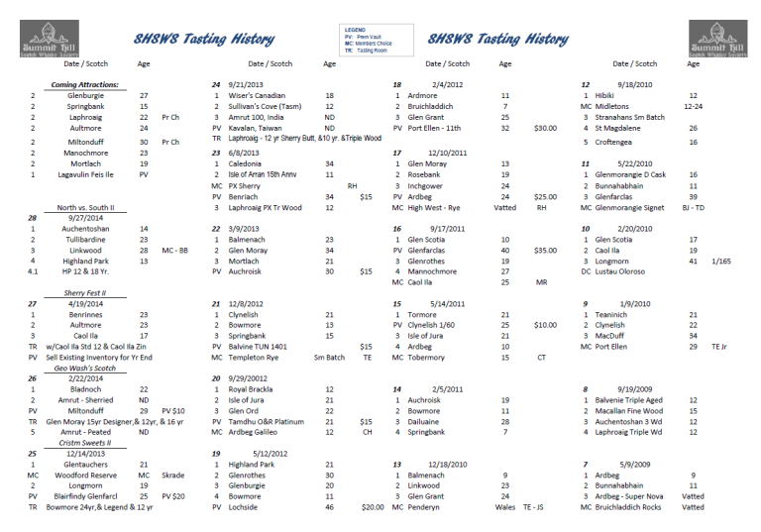
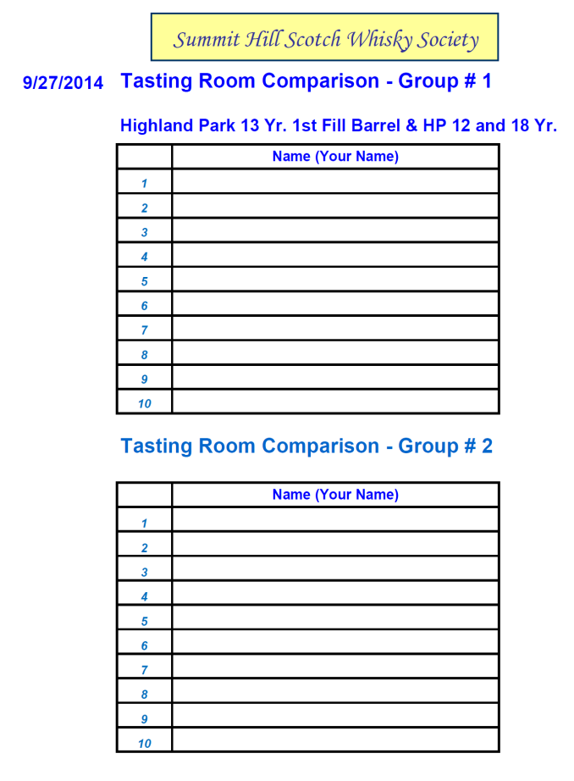
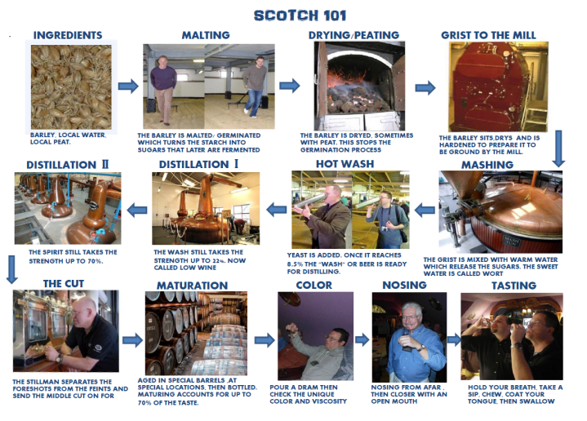
SHSWS
On the Pool Table . . .
SCOTLAND BY AREA TYPICAL CHARACTERISTICS… “Lowlands” Light, Vanilla, Leafy, Malty, Fruity “Highlands” Spicy, Lightly Peated, Citrus, Floral “Speyside” Fruity, Sweet, Floral, Grassy, Vanilla “Campbeltown” Malty, Nutmeg, Fruity, Light Smoke “Islands” Peaty, Coastal/ Seaweed, Malty, Grassy “Islay” Smoky, Peaty, Earthy, Medicinal, Seaweed, Zesty
Tasting Room Comparison – Group # 1
.

Slide 2
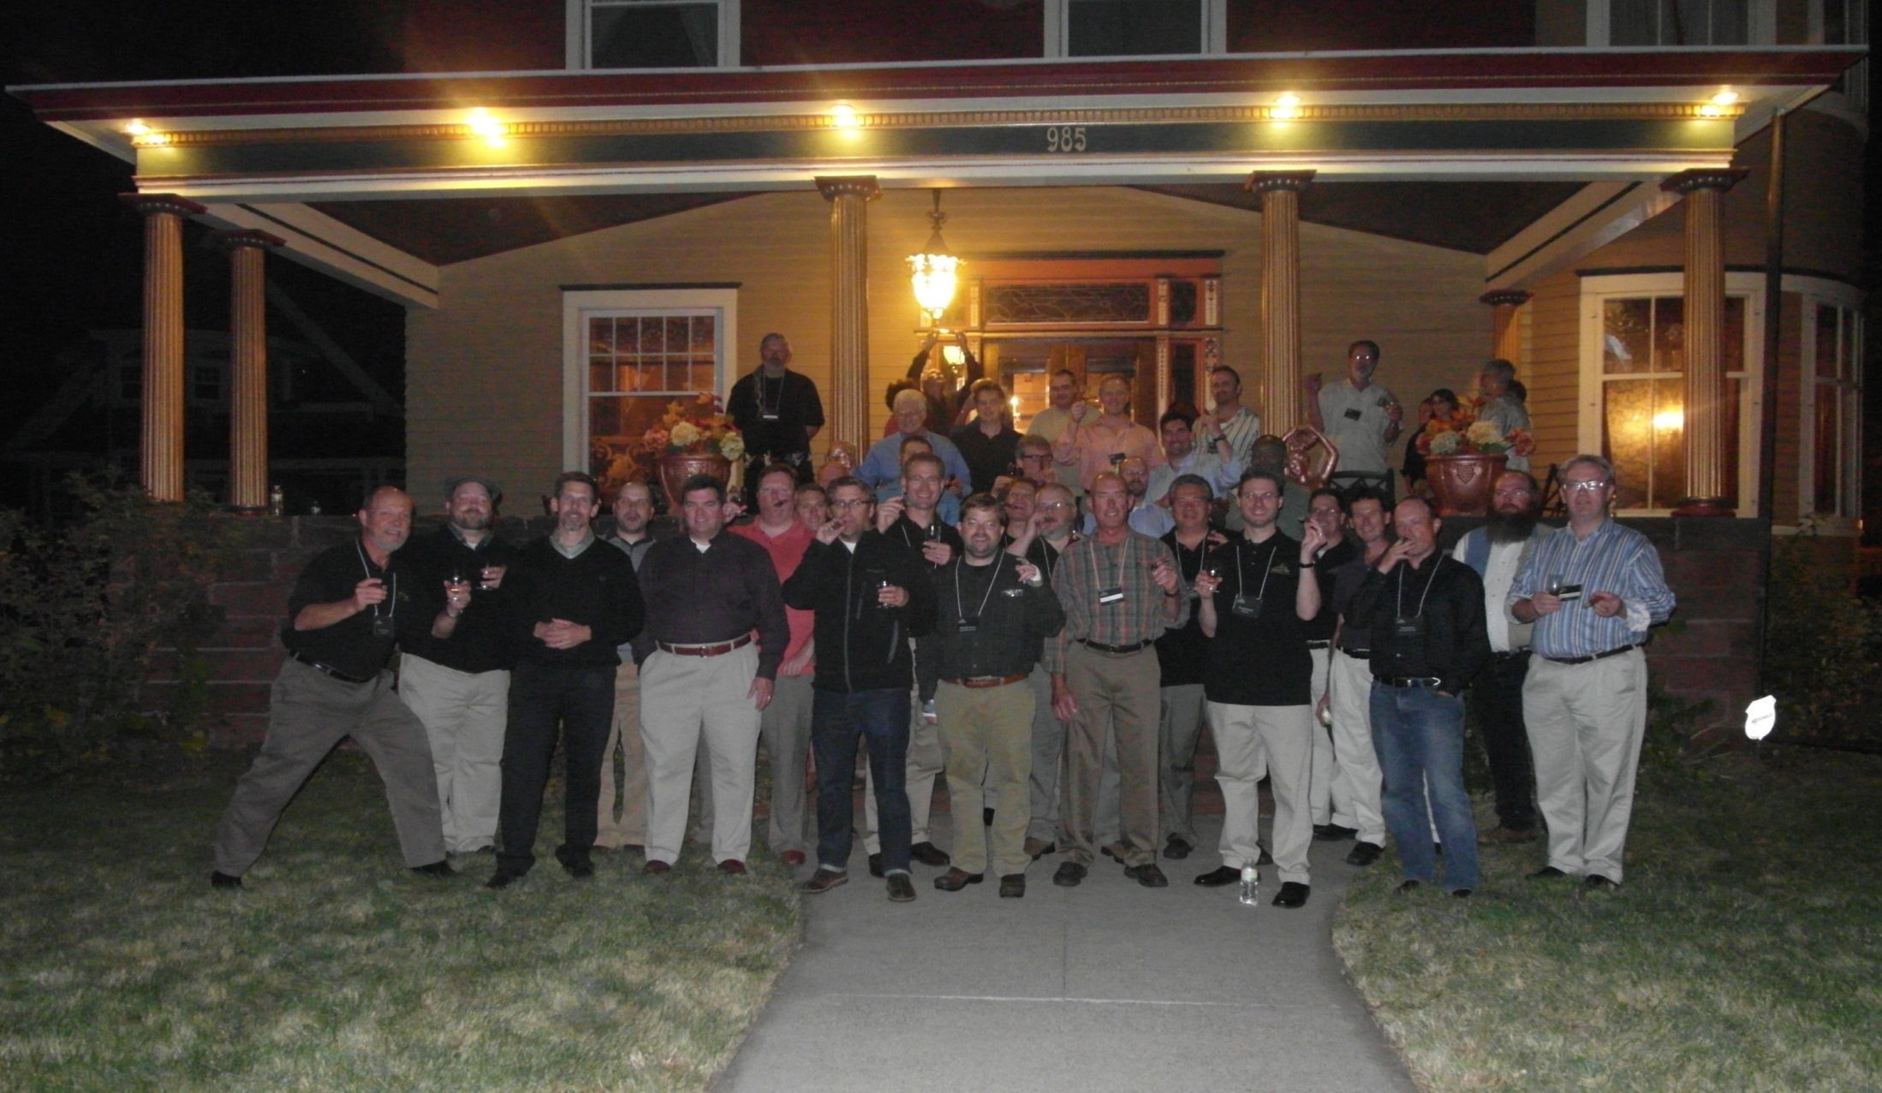
SHSWS
Summit Hill Scotch Whisky Society
Slainte !
Notes:
2

Slide 3
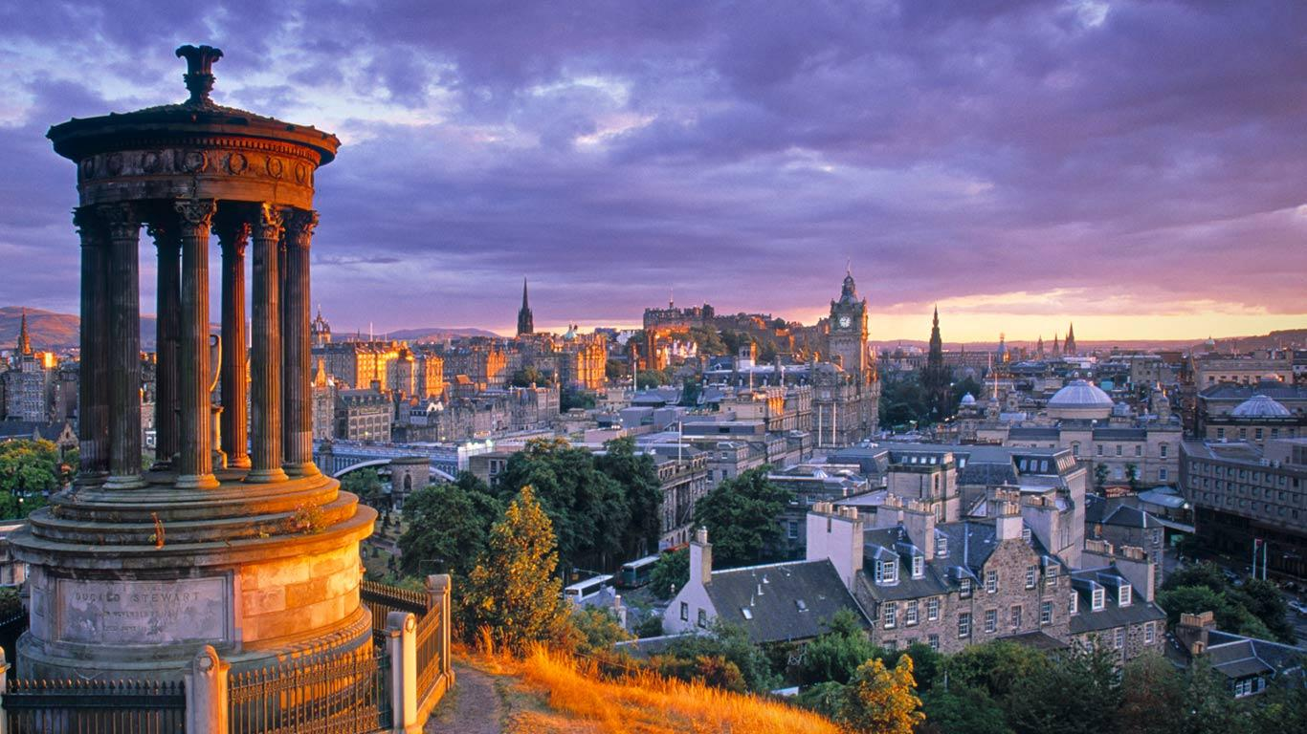
SHSWS
Dec. 12th 2015
The “Young and Old” Tasting
Bottle 35.101 Glen Moray - 39 Years Old - Extremely Rare
Bottle 76.99 Mortlach - 9 Years Old – First Fill Barrel
Bottle 2014 Lagavulin - 12 Years Old – SR Highly Rated
Tasting Room Features: 16 Year Old and NAS Distillers Ltd Edition
Premium Vault , 1977 Ardbeg - $40.00/ Dram

Slide 4
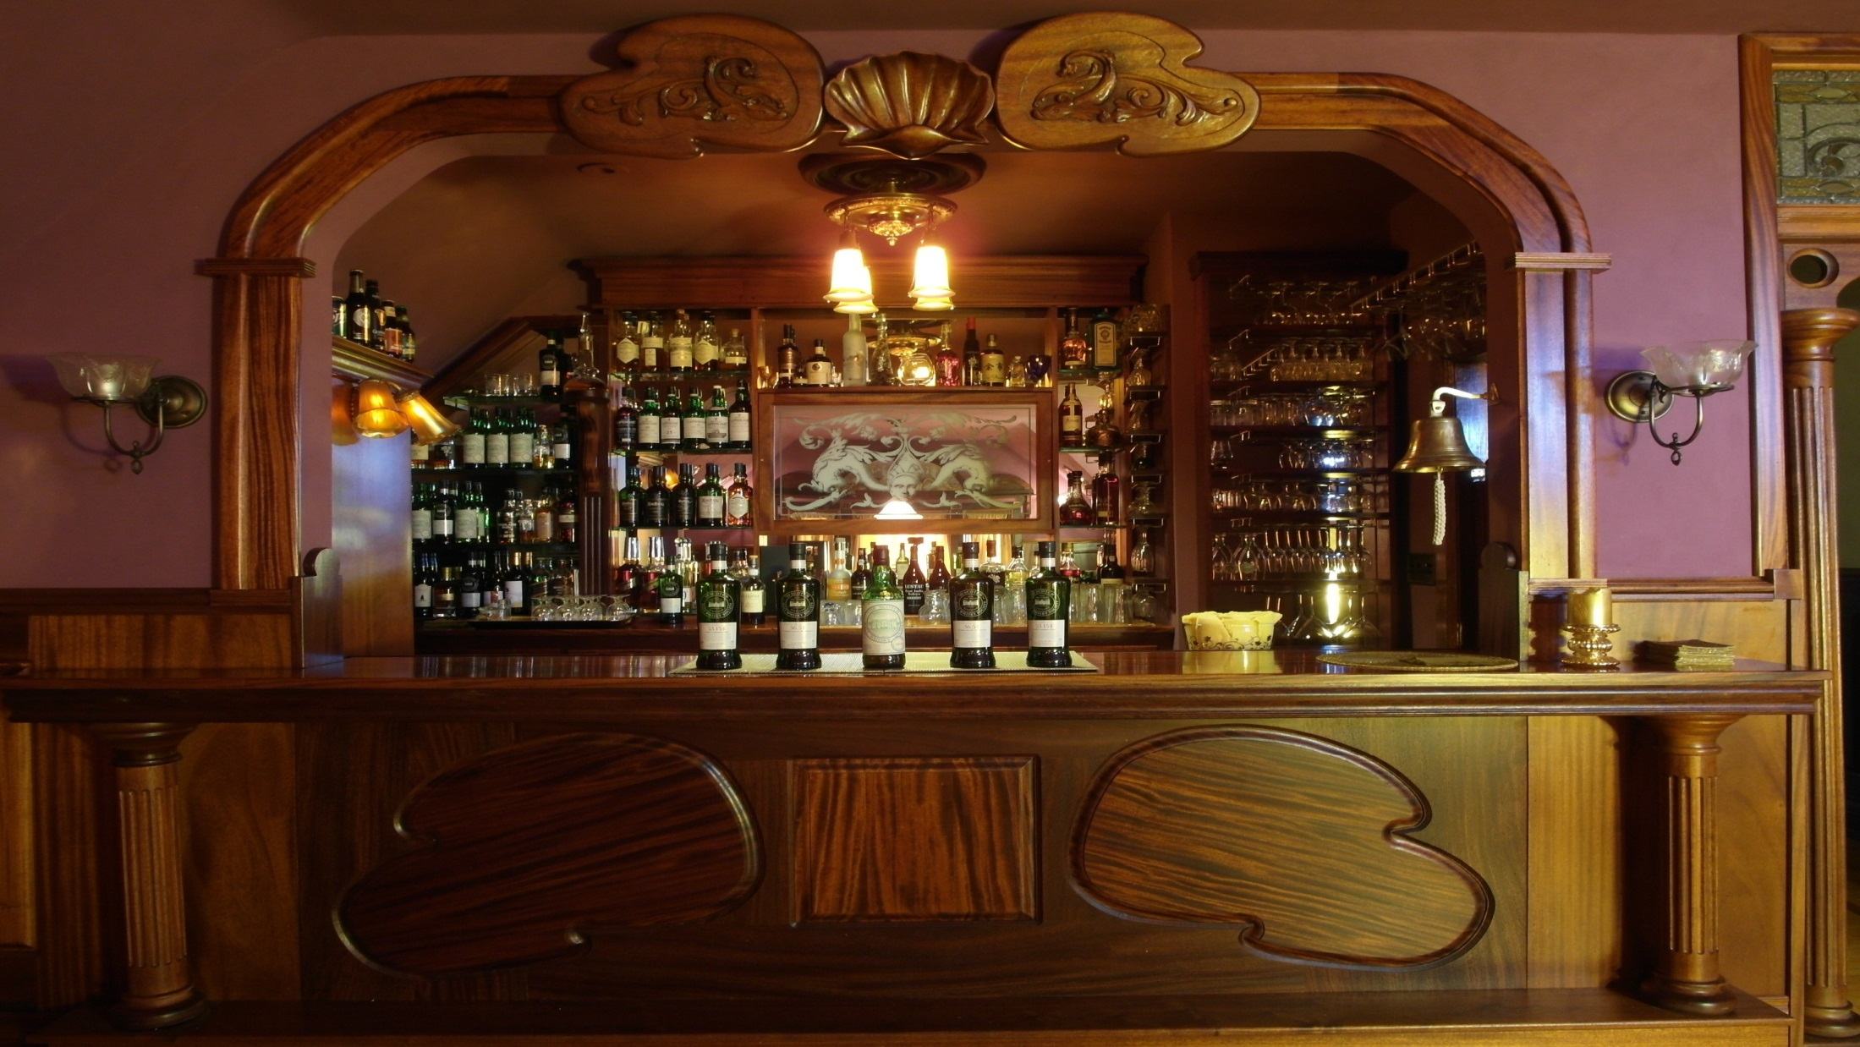
SHSWS
Summit Hill Scotch Whisky Society
A Special Welcome to all of our Guests
Let’s grab Tasting One . . .
Notes:
4

Slide 5
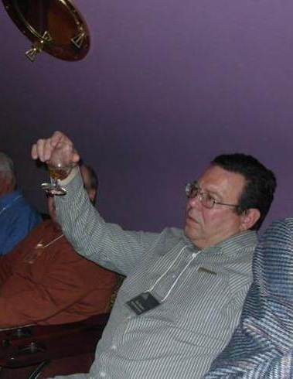
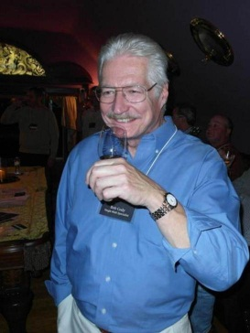
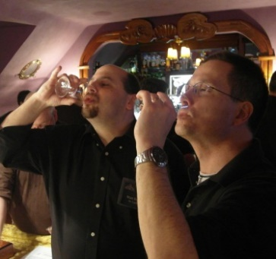
SHSWS
Guests, Please confer with your sponsor if you
Have any questions on Nosing, Tasting, Etc.!
Stage 1 - Observe Enjoy the whisky’s color (this will tell you something about the wood in which it has been matured), brightness (un-chill-filtered whiskies often go slightly hazy with water) and viscosity (see the ‘tears’ on the inside of the glass when you swirl the spirit).
Stage 2 – Nosing (Neat, Diluted described on next slide) Sniff cautiously (mouth open or you may ‘burn’ your nose), and observe the nose-feel’ - prickly, cooling warming, etc. Then note the primary aromas - first impressions are all important here. Bear in mind the overall complexity and intensity of the sample. Repeat the undiluted nosings experimenting with distance to draw out different aromas.
Stage 3 - Tasting Take a sip of the whisky now. Remember that most prefer to either hold their breathe or to exhale slowly while sipping to avoid burning the nose. Coat the tongue, chew and wait for the tastes and finish. Some single malts can have a very long and lingering finish, so waaaaaait for it!
Notes:
5

Slide 6
SHSWS
Tasting #1 – Glen Moray – Presidents Choice
“Oh How Joyfully”
Colour: Light Amber
Nose: Very gentle start, baked apples, anise-flavored cookies, and a fresh cut fir tree.
Palate: The taste is honey mouth coating with sandalwood and resin.
Diluted: Adding water brings candied orange and citrus peel, dried fruits and a mixture of light woodiness, fragrant spices and fresh mint.
Glen Moray – Speyside Extr. Rare : 2 bottles of only 179 Worldwide
39 Year Old Single Cask Refill Hogshead Proof: 92.4º
And while you’re tasting . . .
Notes:
6

Slide 7
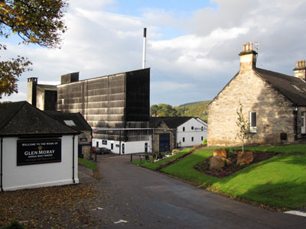
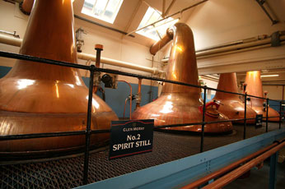
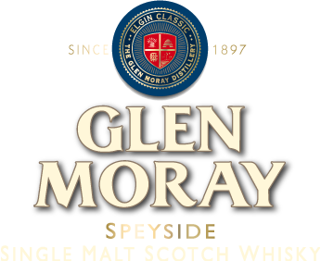
Name: Region:
Founded: Status:
Water Supply: Equipment: Production capacity:
Ownership:
Glen Moray (Pronounced: glen MOray) Speyside (Lossie) 1897 Active Lossie River 2 Wash stills, 2 Spirit stills 2,300,000 litres of pure alcohol per year La Martiniquaise (since 2008)
"Glen Moray Distillery nestles on the banks of the River Lossie in the city of Elgin, the capital of Speyside, a region synonymous with malt whisky. Glen Moray Single Malt Whisky has been distilled here since 1897 by a small dedicated team of craftsmen. In over a century of distilling at Glen Moray, much has changed, however the ingredients, processes and skills of those responsible for producing Glen Moray remain constant.“ True or a Fib ???

Slide 8
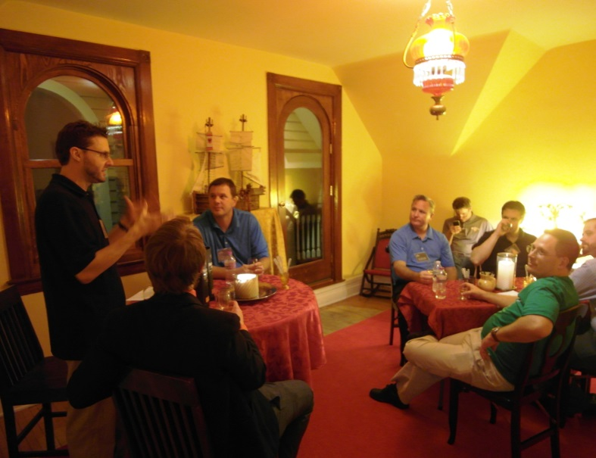
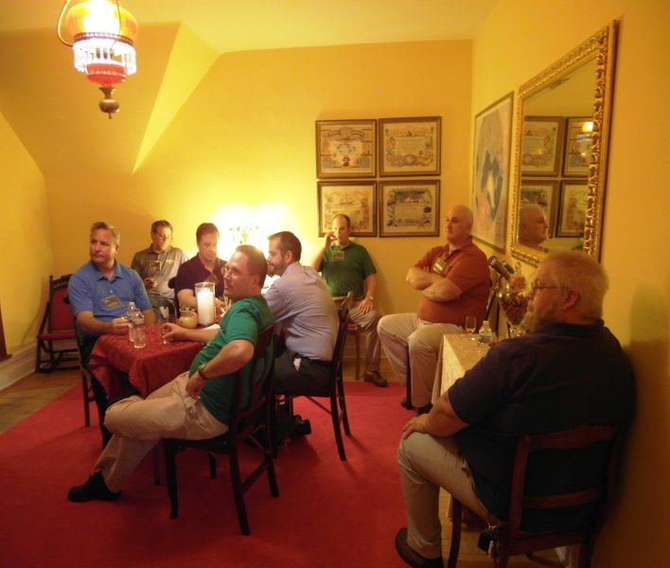
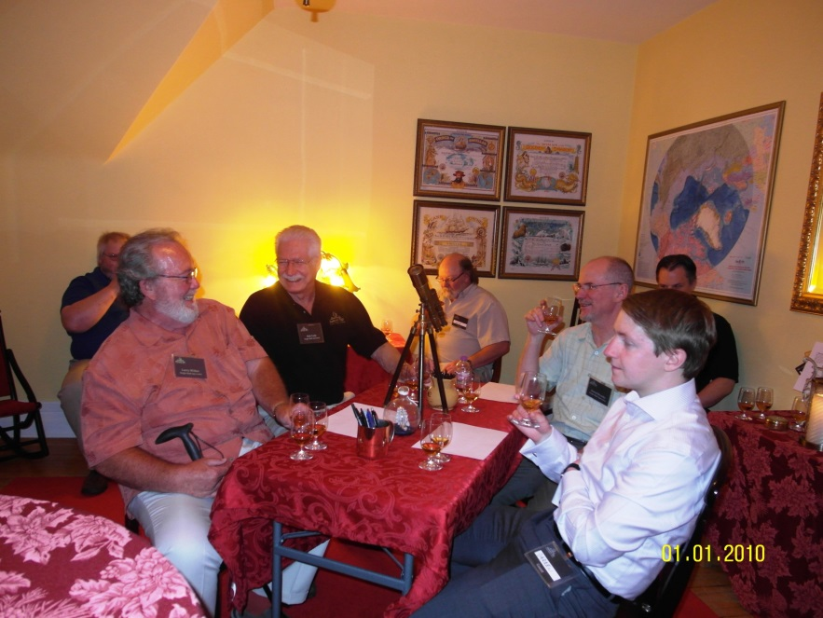
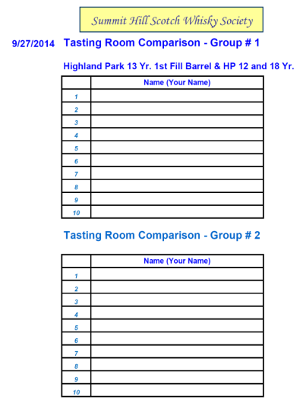
The “Tasting Room”
experience is available on a first come first serve basis. There are two sign up sheets available. The first twelve members will adjourn to the “Rich Howard Tasting Room” and experience a flight of Scotch. This 1st group will adjourn during the Premium Vault Tasting (so you will have it later). The 2nd group of 12 will adjourn during Tasting Four.
Please see the sign up sheets – Group 1 and 2
Tonight Featuring Lagavulin:
2014 Highly Rated Lagavulin 12, Special Release
2014 Limited Release Distillers Edition, 1 of 503
2015 Lagavulin 16 (The standard bearer)
Sign Up Sheets are on the Pool Table

Slide 9
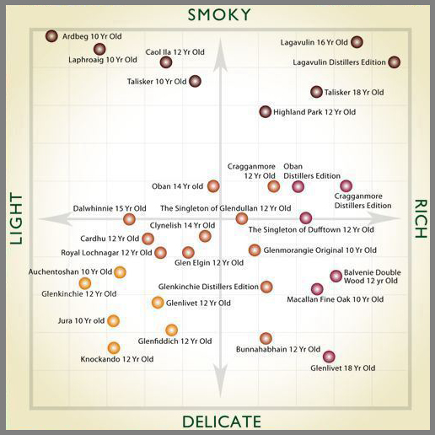
Lagavulin is featured in tonights Tasting Room

Slide 10
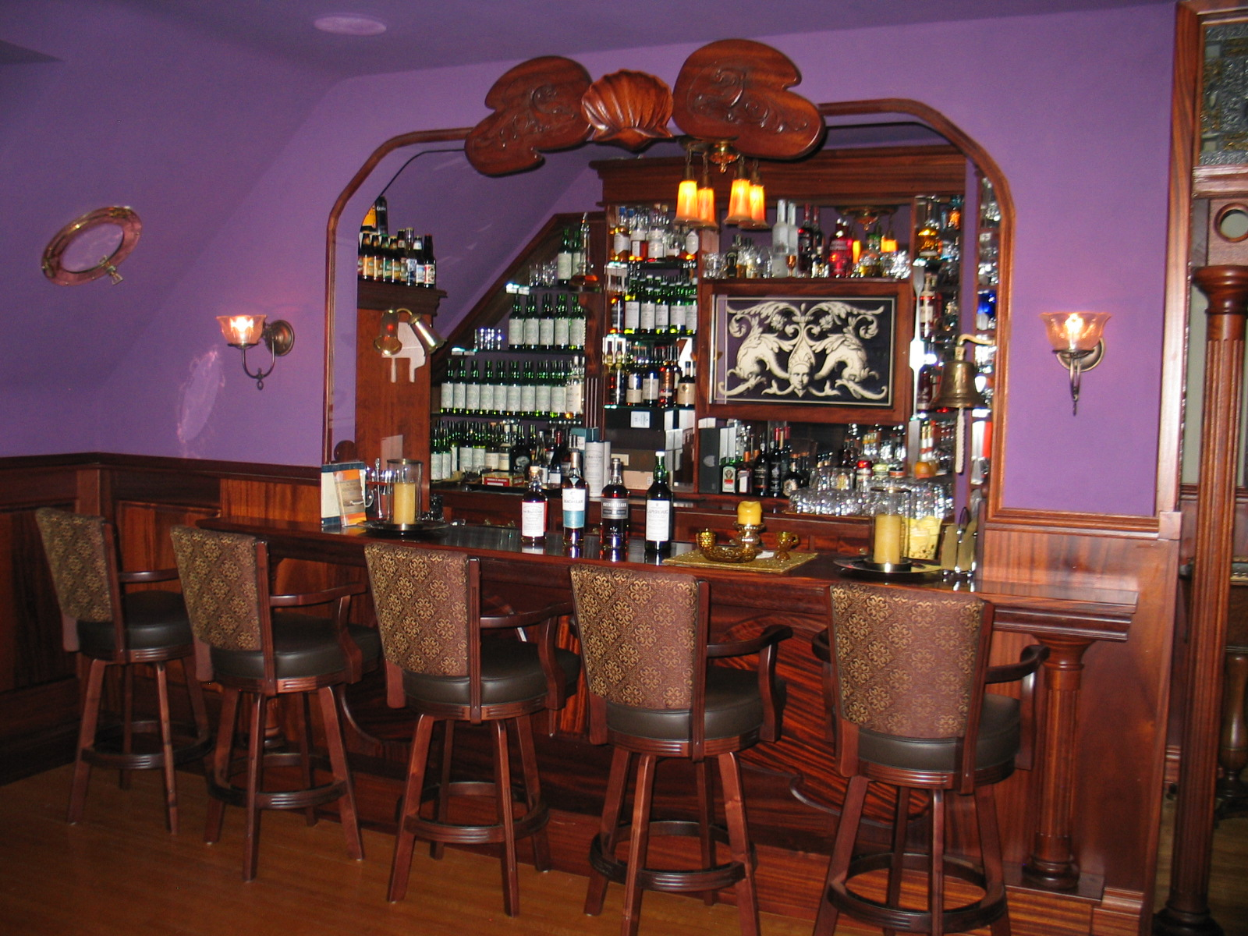
SHSWS
Summit Hill Scotch Whisky Society
What is the Key to a successful Holiday Whisky Tasting ? . . .
. . .
Bert
Notes:
10

Slide 11
SHSWS
Summit Hill Scotch Whisky Society
What is the Key to a successful Holiday Whisky Tasting ? . . .
If you need transportation, please let us know.
Bert
Designated Drivers, Taxis and Limos are always the safe bet . . .
If you have transportation needs please discuss with one of the Directors.
Notes:
11

Slide 12
SHSWS
Tasting #1 – Glen Moray – Presidents Choice
“Oh How Joyfully”
Colour: Light Amber
Nose: Very gentle start, baked apples, anise-flavored cookies, and a fresh cut fir tree.
Palate: The taste is honey mouth coating with sandalwood and resin.
Diluted: Adding water brings candied orange and citrus peel, dried fruits and a mixture of light woodiness, fragrant spices and fresh mint.
Glen Moray – Speyside Extr. Rare : 2 bottles of only 179 Worldwide
39 Year Old Single Cask Refill Hogshead Proof: 92.4º
On to Tasting 2 . . .
Notes:
12

Slide 13
SHSWS
Summit Hill Scotch Whisky Society
Tasting Two . . .
Notes:
13

Slide 14
SHSWS
Tasting #2 – Mortlach
“Turkish Delight: Mediterranean perfumes”
Colour: Golden
Nose: Interesting and attractive – the nose offers Crunchie Bars, millionaires shortbread, Turkish Delights, barley sugars, leather, clove and flowery perfume .
Palate: The palate has lovely spicy sweetness – iced gingerbread, Humbugs, spiced honey cake with hints of lemon zest, nutmeg and charcoal. .
Diluted: Adding water brings out more of the honey and sweetness.
Mortlach– Speyside Very Rare : 2 bottles of only 245 Worldwide
9 Year Old Single Cask 1st Fill Barrel Proof: 123.4º
And while you’re tasting . . .
Notes:
14

Slide 15
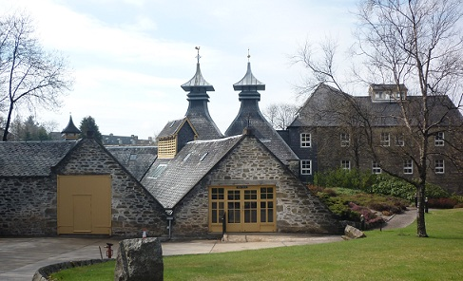
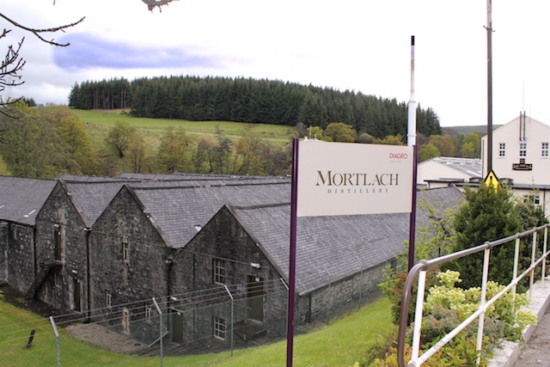
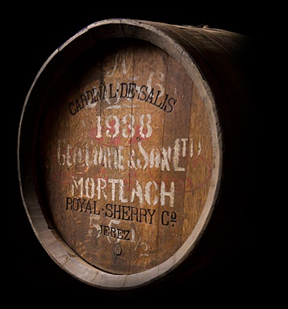
Name: Region:
Founded: Status:
Water Supply: Equipment: Production capacity:
Ownership:
Mortlach (Pronounced: MORT-lack) Speyside (Dufftown) 1823 Active Sources in the Conval Hills 3 Wash stills, 3 Spirit stills 2,900,000 litres of pure alcohol per year Diageo (since 1925)
1) Mortlach malt whisky is an important component of the Johnnie Walker Black Label blend.
2) Mortlach features five traditional 'dunnage' warehouses that provide storage capacity for 21,000 casks.

Slide 16
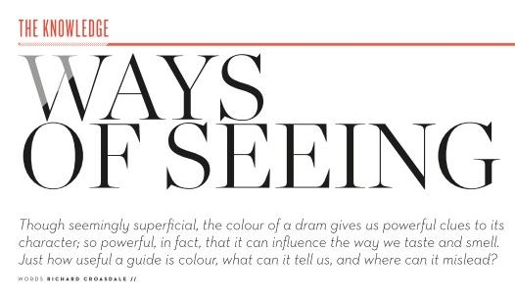
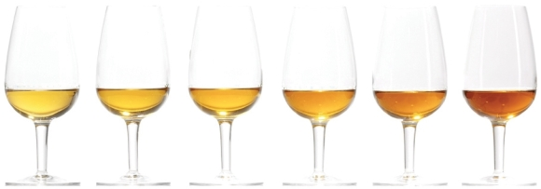
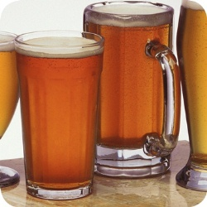
Lovibond® Colour Measurement Tintometer® Group
COLOR
WHISKY COLOR SCALE
SERIES 52 (BROWN) SCALE
Series 52 is the original Lovibond® Brown colour scale now currently used for the colour grading of whisky, honey and similarly coloured liquids or syrups.
The standard version of this scale includes a series of 23 amber/brown glasses although other values are also available.
EBC Colour has largely superseded it for the grading of beers in Europe but it is still used for beers in the US and for whiskies. Is is sometimes referred to as degrees Lovibond® in the US brewing industry.
It is also suitable for sugars solutions and syrups.

Slide 17
COLOR
The Clue is in the Hue
Younger Age, less intense Color.
Refill casks can have diminished color.
Previous occupant varies Color, Bourbon cask = lighter straw, Sherry casks impart a warmer hue.
More exotic casks impart their own tell tale color.
Rule of thumb is the darker the color the greater the wood influence
The Appliance of Science
Continuity in Color is considered as important as taste for store sold Scotch.
Science can give a definitive value to Color with the
“Lovibond Tintometer” Whisky is measured on the
Series 52 Brown Scale.
Beauty Contest
Color is often used as a first impression that weighs on our perception that darker Whiskies have more substance and therefore must be BETTER.
Color should be considered the start of the journey and should not be considered an accurate measure of Quality or Character
THE ONLY WAY TO TRULY KNOW A DRAM IS TO RAISE A GLASS AND ENJOY IT !!

Slide 18
SHSWS
Tasting #2 – Mortlach
“Turkish Delight: Mediterranean perfumes”
Colour: Golden
Nose: Interesting and attractive – the nose offers Crunchie Bars, millionaires shortbread, Turkish Delights, barley sugars, leather, clove and flowery perfume .
Palate: The palate has lovely spicy sweetness – iced gingerbread, Humbugs, spiced honey cake with hints of lemon zest, nutmeg and charcoal. .
Diluted: Adding water brings out more of the honey and sweetness.
Mortlach– Speyside Very Rare : 2 bottles of only 245 Worldwide
9 Year Old Single Cask 1st Fill Barrel Proof: 123.4º
And while you’re tasting . . .
Notes:
18

Slide 19
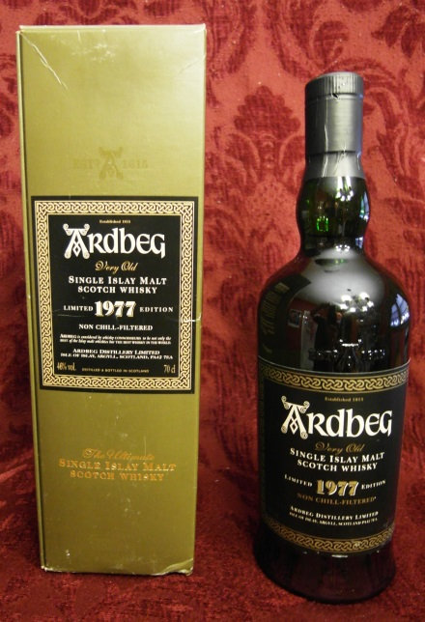
SHSWS
Summit Hill Scotch Whisky Society
Tasting Three from the
Premium Vault . . .
Notes:
19

Slide 20
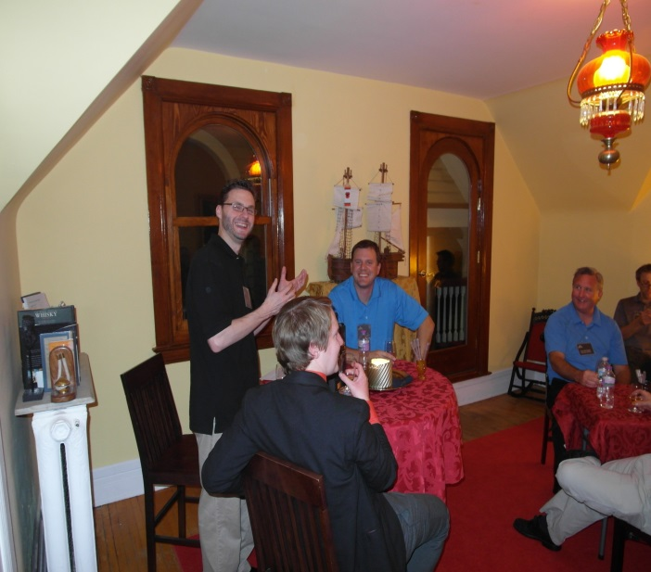
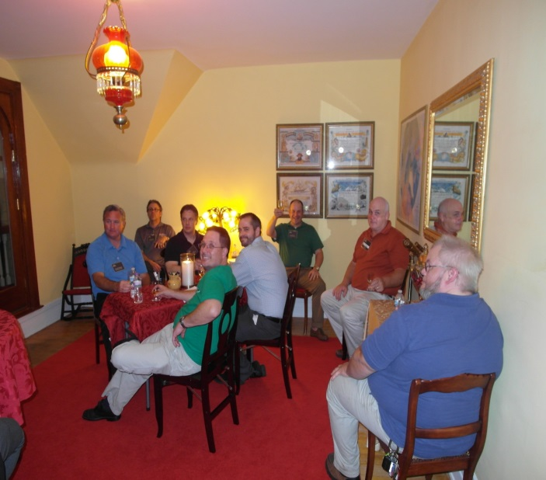
The “Tasting Room” Experience
Group 1 . . . Please join us in the Tasting Room
Tonight Featuring Lagavulin:
2014 Highly rated Lagavulin 12
2014 Limited release Distillers Edition, 1 of 503
2015 Lagavulin 16 (The standard bearer)

Slide 21
SHSWS
PREMIUM VAULT SELECTION - $40
Tasting # 3 – 1977, 25 year old Ardbeg
“Rare Ltd Edition - Vintage”
Colour - Rich Gold.
Nose - An enormous whisky, embodying the perfect balance of sweetness, fruit and deep smoky aromas. This vintage is a truly sensational example of Ardbeg matured in quality American oak ex-bourbon barrels. Toffee and fudge sweetness emerges first with peat encased in milk chocolate. Mandarin fruit is discovered through the chocolate with a sprinkling of cocoa powder. The oak is gentle and scented, both balsamic and spicy revealing eucalyptus oil and cinnamon. With water, dessert sweetness is uncovered with lemon curd and bitter almonds followed by vanilla. The deep smokiness of Ardbeg emerges with the hallmark aromas of tarry rope and cigar smoke, yet it is soft and scented with woodsmoke, burning incense sticks and cappuccino coffee.
Taste - Sensationally smooth and peaty, a mouthful of soft and chewing peat smoke rapidly takes centre stage. The mouthfeel is at once silky, velvety and chewing. The flavours are sweet and scented with milk chocolate, mandarins and parma violets. Peat is present throughout the taste, constantly filling the palate with cocoa and scented smoke from beginning to end.
Finish - The taste refuses to go away. The finish is very long and scented with woodsmoke, mandarins and cocoa.
Ardbeg 1977 – Islay Rare: 1 of NS Quan.
25 Year Old Limited Edition - Proof: 92.0º
Notes:
21

Slide 22
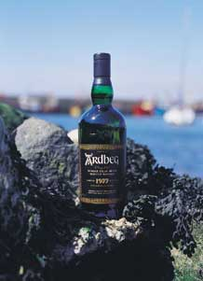
SHSWS
Ardbeg
"A vintage of exceptional balance and depth" Here at Ardbeg we're delighted to announce the launch of our second Vintage, 1977, which will be widely available from the end of June 2001 to 04. Non chill-filtered for greater flavour, it is an absolute delight. And with so many very special characteristics, we rank it close to Provenance. Due to the limited stocks of Ardbeg, it's likely to be the last Vintage we declare for at least ten years.
Ardbeg 1977 Bottling Note
Rare and delicious Ardbeg! Jim Murray awarded this 96 points and described it as "simply one of the greatest experiences". This 25 year old expression was distilled in 1977 and bottled in 2002, and released with no stated quantity.

Slide 23
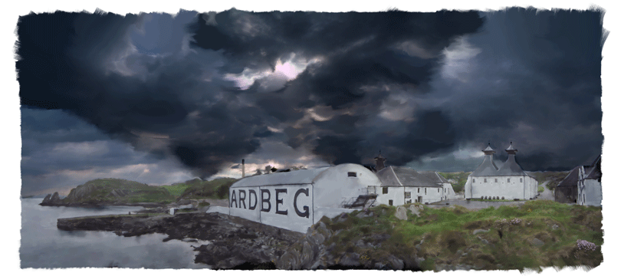
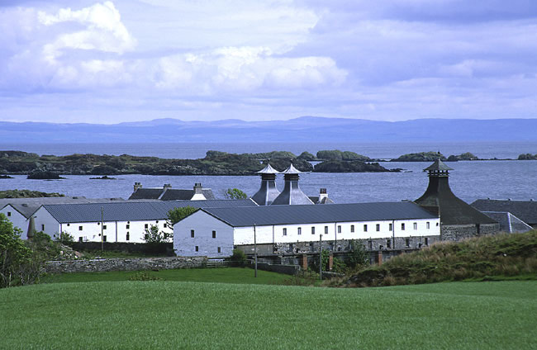
Premium Vault
Ardbeg $40/ Dram
Name: Region:
Founded: Status: Equipment: Production capacity:
Ownership:
Ardbeg
Islay 1815 Active 1 Wash, 1 Spirit 1,100,000 L/ Yr HM/ Glenmorangie
Jim Murray awarded this 96 points and said it’s "simply one of the greatest experiences".
The Ardbeg distillery lies on the South shore of Islay, close to the other 'Kildalton' distilleries (Lagavulin and Laphroaig). This coast line is home to some of the scary peat monsters that sometimes keep me up at night... The style of the Kildalton malts often has some more 'organics' than those from other parts of the island.

Slide 24
SHSWS
PREMIUM VAULT SELECTION - $40
Tasting # 3 – 1977, 25 year old Ardbeg
“Rare Ltd Edition - Vintage”
Colour - Rich Gold.
Nose - An enormous whisky, embodying the perfect balance of sweetness, fruit and deep smoky aromas. This vintage is a truly sensational example of Ardbeg matured in quality American oak ex-bourbon barrels. Toffee and fudge sweetness emerges first with peat encased in milk chocolate. Mandarin fruit is discovered through the chocolate with a sprinkling of cocoa powder. The oak is gentle and scented, both balsamic and spicy revealing eucalyptus oil and cinnamon. With water, dessert sweetness is uncovered with lemon curd and bitter almonds followed by vanilla. The deep smokiness of Ardbeg emerges with the hallmark aromas of tarry rope and cigar smoke, yet it is soft and scented with woodsmoke, burning incense sticks and cappuccino coffee.
Taste - Sensationally smooth and peaty, a mouthful of soft and chewing peat smoke rapidly takes centre stage. The mouthfeel is at once silky, velvety and chewing. The flavours are sweet and scented with milk chocolate, mandarins and parma violets. Peat is present throughout the taste, constantly filling the palate with cocoa and scented smoke from beginning to end.
Finish - The taste refuses to go away. The finish is very long and scented with woodsmoke, mandarins and cocoa.
Ardbeg 1977 – Islay Rare: 1 of NS Quan.
25 Year Old Limited Edition - Proof: 92.0º
Notes:
24

Slide 25
SHSWS
Summit Hill Scotch Whisky Society
Tasting Four . . .
Notes:
25

Slide 26
The “Tasting Room” Experience
Group 2 . . . Please join us in the Tasting Room
Group 1 is invited to try out the Premium Vault . . .
Tasting Notes are on the Bar !

Slide 27
SHSWS
Tasting #4 – Lagavulin 12 Year 2014 Special Release
Colour: Golden
Nose: Sweet sea salty smoke, citrus, green apple skin, leather, malt wine, pretty much everything you're after really.
Palate: Candied lemons, lime marmalade, mixed fruit and nut all wrapped in a plume of big, dry, savoury smoke.
Finish: Long with drying wood smoke.
Overall: Slightly different again this year, with many commenting on its dryness. Best Laggie 12 since 2002 1st edition.
Lagavulin – Islay Special Release: 2 bottles
Cask Strength Proof: 108.8º
And while you’re tasting . . .
Notes:
27

Slide 28
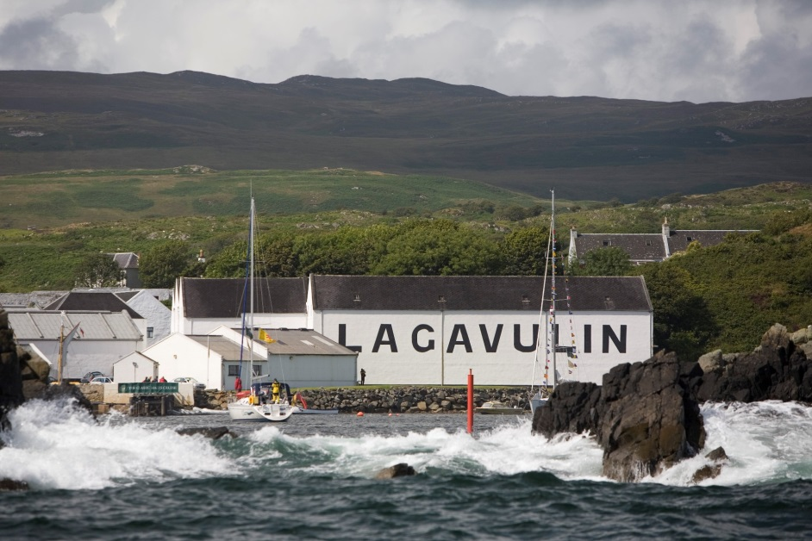
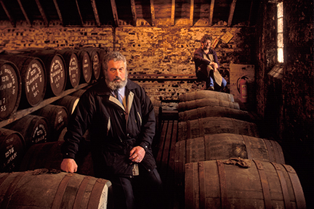
Name: Region:
Neighbors:
Founded: Status:
Water Supply: Equipment: Production capacity:
Ownership:
Lagavulin (Pronounced: LA-ga-VOO-lin) Islay Ardbeg, Laphroaig, Port Ellen 1816 Active Solum Lochs 2 Wash stills, 2 Spirit stills 2,250,000 litres of pure alcohol per year Diageo (since 1927)
Probably my favorite so far. Been buying this one since 2001 and I think that this release is the best so far (together with the 2002). Big smoky nose with lot of medicinal elements. What I like most is that you really don't need to add any water. The strength is perfect. Medium bodied yet fat and oily with rich smoke and salt. Like a smoked ham. Not much wood really just distillery character all the way. Another thing I like on the nose is that the gravel and chalky notes from last years release is gone. It feels more mature and smoky. Best Special Release in a long time.

Slide 29
SHSWS
Tasting #4 – Lagavulin 12 Year 2014 Special Release
Colour: Golden
Nose: Sweet sea salty smoke, citrus, green apple skin, leather, malt wine, pretty much everything you're after really.
Palate: Candied lemons, lime marmalade, mixed fruit and nut all wrapped in a plume of big, dry, savoury smoke.
Finish: Long with drying wood smoke.
Overall: Slightly different again this year, with many commenting on its dryness. Best Laggie 12 since 2002 1st edition.
Lagavulin – Islay Special Release: 2 bottles
Cask Strength Proof: 108.8º
Notes:
29

Slide 30
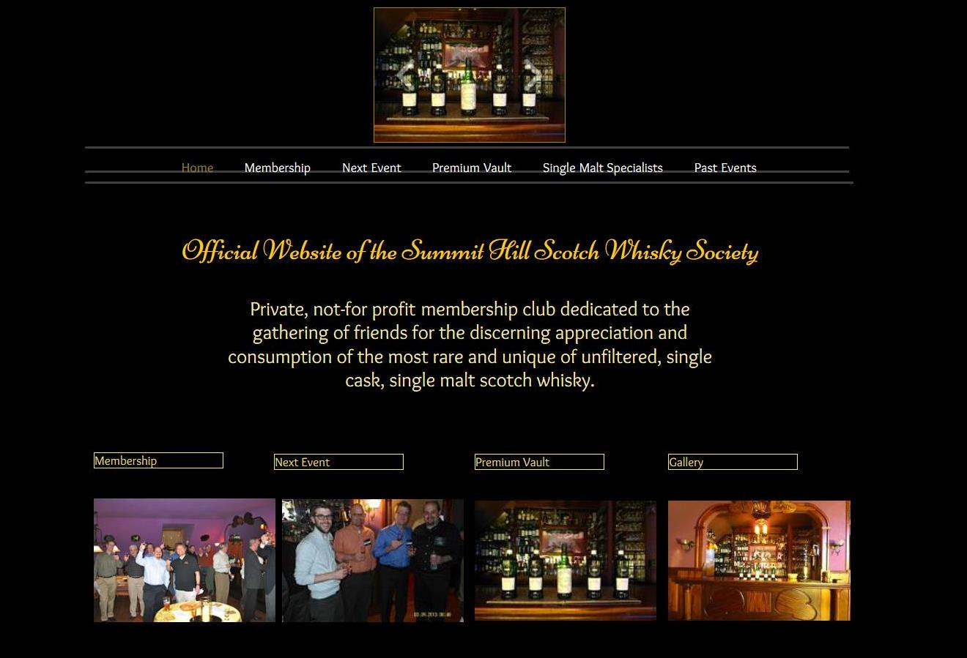
The End
Next
Event
Feb
New Website:
www.shsws.info

Slide 31
Tasting Room Notes
1. Lagavulin 16 yr. (43%, OB, +/-2015)
Tasting Note by The Chaps at Master of Malt
Nose: More like Lapsang Souchong tea than Lapsang Souchong! One of the smokiest noses from Islay. It's big, very, very concentrated, and redolent of iodine, sweet spices, good, mature sherry and creamy vanilla. Stunning.
Palate: Very thick and rich. A massive mouthful of malt and sherry with good fruity sweetness, but also a wonderful sweetness. Big, powerful peat and oak.
Finish: Long, spicy finish, figs, dates, peat smoke, vanilla
Rated: 95/ 100
2. Lagavulin Distillers Edition 1998 (2014 release)
Color: rich honey gold, touch of amber
Nose: sherry & honey sweetness, rich smoke, floral smooth caramel, new wood & cereal.
Palate: smooth sweet smokey dried fruits. Raisins and oak.
Finish: lingering warming sweet smoke, like the feeling of a warm fire on a fall evening, in a dram. Leaves a pleasant dry fruity mouthfeel.
Splash of water: draws out the sherry and smoke, brings out fresh fruit, apples in the nose. Palate sweetens up on the front, mellows out the smoke. Finish feels more fruity as well.
Wife says: "The smokiness hits a little bit later, pretty good. I like it."
Final thoughts: Wow. It's everything I love about Lagavulin 16, bold and balanced smoke backed up with elegant complexity, plus lovely delicate sherry notes intermingled through the whole experience. This is my new favorite, and when the time comes to replace my bottle of Lagavulin 16, I'll be getting the Distiller's Edition.Finished in PX Sherry casks.
Rated: 96 - 98/100
3. Lagavulin 12 Year 2014 Special Release
Colour: Golden
Nose: Sweet sea salty smoke, citrus, green apple skin, leather, malt wine, pretty much everything you're after really.
Palate: Candied lemons, lime marmalade, mixed fruit and nut all wrapped in a plume of big, dry, savoury smoke.
Finish: Long with drying wood smoke.
Overall: Slightly different again this year, with many commenting on its dryness. Best Laggie 12 since 2002 1st edition.
Lagavulin – Islay Special Release: 2 bottles
Cask Strength Proof: 108.8º Rated: Way up there!

Slide 32
SHSWS Value Comparison . . .
Extremely Rare and Highly Rated SHSWS Tastings
46 Year Old Lochside 2 of 178
41 Year Old Longmorn 2 of 60
40 Year Old Longmorn 2 of 192
41 Year Old Strathisla - PV 1 of Ltd Release
40 Year Old Glenfarclas 2 of 60
34 Year Old Glen Moray - PC Last Bottle in the World
43 Year Old Glenrothes - PC 2 of 178
30 Year Old Glenrothes 2 of 171
30 Year Old Miltonduff - PC 2 of 138
28 Year Old Linkwood – BB Ltd Release
23 Year Old Mannochmore 2 of 140
24 Year Old Bowmore 2 of 238
Value . . . Priceless

